Slide 1
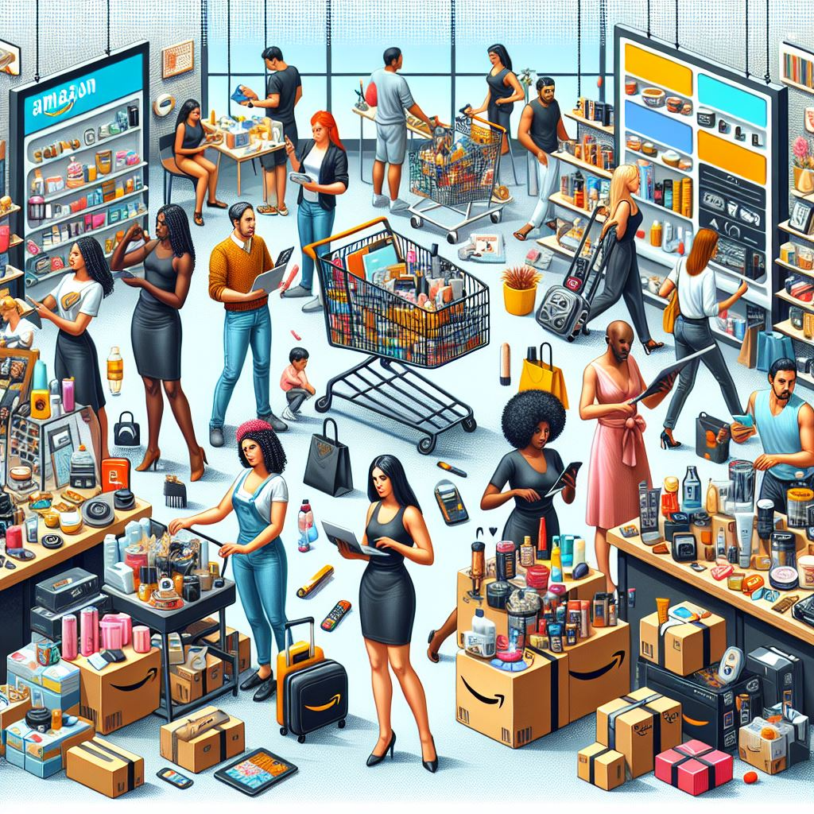
Amazon Branch Performance

Slide 2
Contents
Project Overview
Project Scope
Business Problem
Business Objective
Technical Stack
Data Understanding
Data Dictionary
Entity – Relationship Diagram
Insights Drawn and Recommendations – Product
Insights Drawn and Recommendations – Sales
Insights Drawn and Recommendations – Customer

Slide 3
Project Overview
The primary aim of this project is to analyse sales data from three Amazon branches located in Mandalay, Yangon, and Naypyitaw. This analysis will uncover insights into product performance, sales trends, and customer behaviour. The dataset comprises 1000 rows and 17 columns, including information such as invoice details, product lines, prices, quantities, taxes, dates, and customer demographics. The goal is to leverage this data to improve sales strategies, enhance product offerings, and better understand customer segments.

Slide 4
Project Scope
1. Data Wrangling:
Inspect and clean the data, ensuring no null values.
Build a database, create tables, and insert the cleaned data.
2. Feature Engineering:
Create new columns for time of day, day of the week, and month of the year to gain insights into
sales patterns.
3. Exploratory Data Analysis (EDA):
Analyze product performance to identify best and worst-performing product lines.
Examine sales trends to evaluate the effectiveness of sales strategies.
Segment customers to uncover purchase trends and profitability by customer type.
4. Business Questions:
Address specific business questions related to product lines, payment methods, revenue,
VAT, customer types, and ratings.

Slide 5
Business Problem
Amazon needs to understand various factors influencing sales across its different branches to optimize its business strategies. Key challenges include identifying high-performing product lines, understanding sales trends over time, and segmenting customers based on purchasing behaviour. Addressing these challenges will help Amazon refine its product offerings, tailor marketing strategies, and ultimately increase revenue.

Slide 6
Business Objective
Product Analysis: Evaluate the performance of different product lines to identify top-performing products and those needing improvement.
Sales Analysis: Examine sales trends to measure the effectiveness of sales strategies and identify areas for improvement.
Customer Analysis: Analysis to uncover the different customer segments, purchase trends and the profitability of each customer segment.

Slide 7

Technical Stacks

Slide 8
Data Understanding
Data Source File Type: Microsoft Excel Comma Separated Values File (.csv)
Data Dictionary: invoice_id, branch, city, customer_type, gender, product_line, unit_price, quantity, vat, total, purchase_date, purchase_time, payment_method, cogs, gross_margin_percentage, gross_income, rating, time_of_day, name_of_day, name_of_month
Data Dimesion: 20 columns and 1000 rows

Slide 9
Data Dictionary
Column name | Description
invoice_id | Invoice of the sales made
branch | Branch at which sales were made
city | The location of the branch
customer_type | The type of the customer
gender | Gender of the customer making purchase
product_line | Product line of the product sold
unit_price | The price of each product
quantity | The amount of the product sold
vat | The amount of tax on the purchase
total | The total cost of the purchase

Slide 10
Data Dictionary
Column name | Description
purchase_date | The date on which the purchase was made
purchase_time | The time at which the purchase was made
payment_method | The type of payment method used for purchase
cogs | Cost Of Goods sold
gross_margin_percentage | Gross margin percentage
gross_income | Gross Income
rating | Rating given to the product
time_of_day | Time of day at which the purchase was made
name_of_day | Name of month on which the purchase was made
name_of_month | Name of the day at which the purchase was made

Slide 11
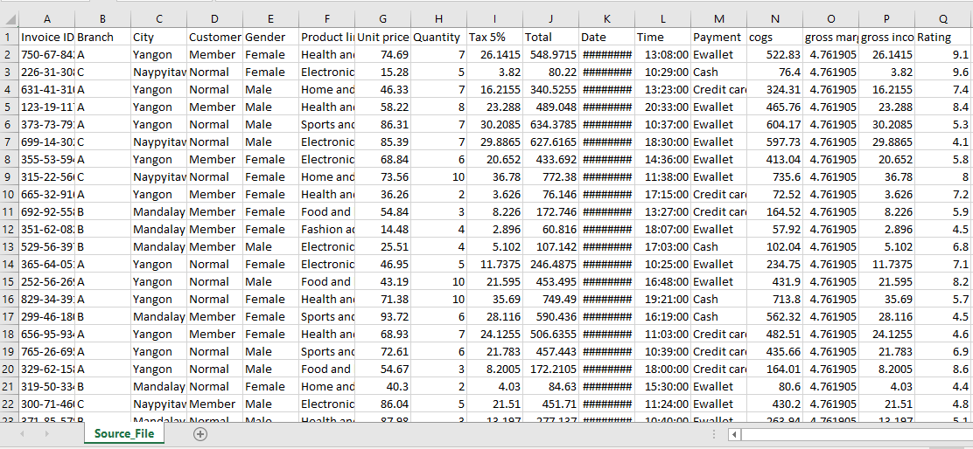
Data Dictionary

Slide 12
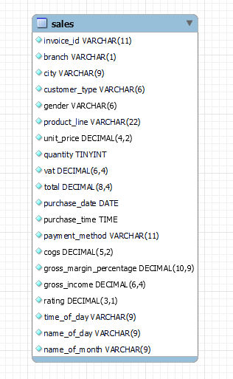
Entity – Relationship Diagram

Slide 13
Insights drawn and Recommendations (Product)
Food and beverages: The top-performing product line is Food and Beverages, evidenced by its highest revenue generation, highest rating, and being the second most sold product line.
Recommendation: To sustain this success, it's crucial to maintain ample stock levels to promptly meet customer demand, ensuring their satisfaction and fostering loyalty.
Health and beauty: The product line that requires the most improvement is the Health and Beauty product line. This conclusion is based on its least revenue generation, lowest number of products sold, and average rating.
Recommendation: To enhance Health and Beauty sales, we can gather customer feedback to understand preferences and introduce innovative products aligned with market trends.
Home and lifestyle: After Health and Beauty, the Home and Lifestyle product line warrants improvement due to its second-lowest revenue generation and sales quantity, along with the lowest ratings.
Recommendation: We can gather feedback from customers to continuously refine and improve the product offerings and overall shopping experience.
Sports and travel: Despite being the second-highest revenue-generating product line, its the third least sold product line and has the second-lowest rating.
Recommendation: We can analyze customer feedback, improve marketing strategies, and consider introducing new products.
Electronic accessories and Fashion accessories: For both product lines, the performance is average.
Recommendation: Utilize customer insights to refine product offerings and implement targeted marketing strategies to maximize performance.

Slide 14
Insights drawn and Recommendations (Sales)
Electronic accessories - January
Fashion accessories – January
Food and beverages – February
Health and beauty – March
Home and lifestyle – March
Sports and travel – January
Recommendation: Consider introducing new products or enhancing existing ones to meet customer demand during these periods. Implement targeted marketing strategies and special promotions to stimulate sales during off-peak months.
Electronic accessories - Thursday
Fashion accessories – Saturday
Food and beverages – Wednesday
Health and beauty - Tuesday
Home and lifestyle - Sunday
Sports and travel – Friday
Recommendation: Implementing targeted marketing campaigns and promotions on specific days corresponding to each product category's highest revenue can potentially boost sales and capitalize on peak purchasing patterns.
The most sold product line is Electronic accessories, while the least sold product line is Health and beauty.
Recommendation: To increase sales, consider offering promotions or discounts on Health and beauty products to boost their sales. Additionally, enhancing the marketing and visibility of Health and beauty items could attract more customers and drive sales.
The highest revenue across all product lines is consistently generated during the afternoon, reflecting peak sales activity during this time .
Recommendation: Optimizing product displays and offering special deals during off- peak hours can attract customers and boost sales.

Slide 15
Insights drawn and Recommendations (Customer)
Half of the customers are male, and the other half are female, with a slightly higher proportion of females.
Recommendation: tailor marketing efforts to align with the distinct preferences and purchasing patterns of male and female customers.
Ewallet is the most frequently used mode of payment, followed closely by cash, with credit card being the least utilized.
Recommendation: Implement exclusive offers for Ewallet transactions to boost sales.
Highest revenue was generated from Naypyitaw and lowest by Mandalay.
Recommendation: To increase sales in cities generating less revenue, we can collaborate with local businesses for cross-promotions, offer exclusive discounts or incentives to encourage purchases.
Highest revenue was generated from Branch C, while the lowest was generated by Branch B.
Recommendation: To increase sales in branches generating less revenue, we can provide staff training to enhance customer service and product knowledge.
Half of the customers fall under the Normal category, while the other half are Members, with a slightly higher proportion being members.
Recommendation: launch new offers/discounts with subscriptions.

Slide 16

THANK YOU

Slide 17
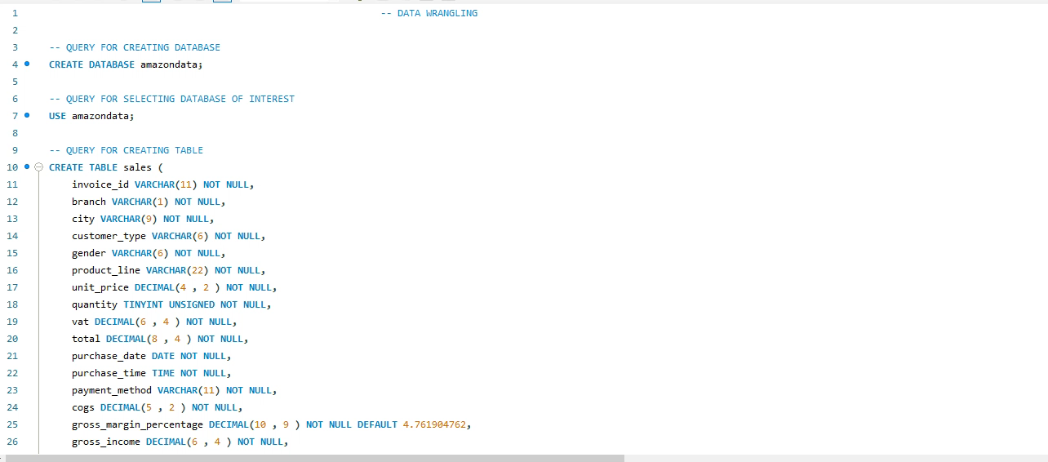
Sql Script

